Slide 1

LA Crime Data Analysis 2020 - 2023
Phil Klimkewicz
Edwin Lovera
Micah purdome
Vickram dass

Slide 2
“It’s one small step for man, one giant leap for mankind.”
- Neil Armstrong

Slide 3
Data Source
This dataset and the crime codes used to parse the data were sourced from City of Los Angeles, LA City Crime handbook at https://data.lacity.org/Public-Safety
The data set Crime_Data_from_2020_to_Present.csv was used to look at violent crimes versus non-violent crimes during the Covid 19 California Lockdown in LA.

Slide 4
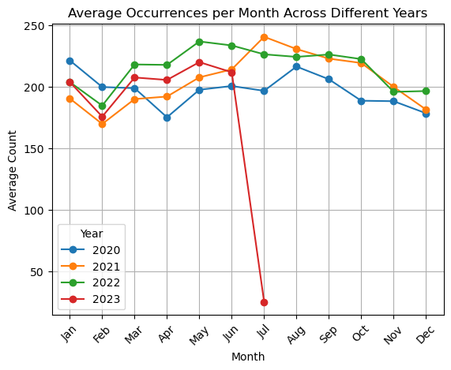
LA Crime during Covid Lockdown March 19, 2020-January25, 2021
We dissected the covid data from the full set of data to determine if violent crimes were lower or higher during the California covid lockdown. The first graph show the average violent crime for each year.

Slide 5
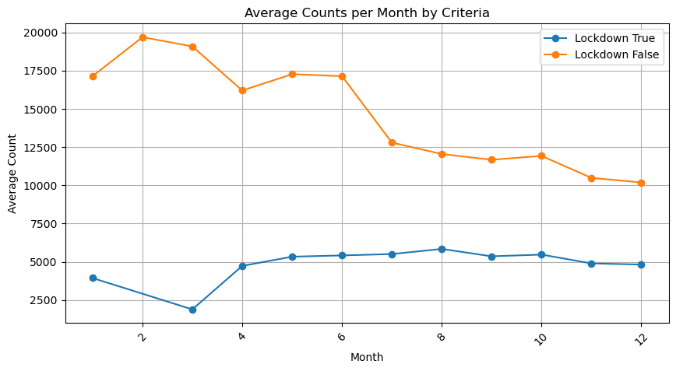
LA Crime during Covid Lockdown March 19, 2020-January25, 2021
Based on the first slide you may think that the average violent crime per month in 202 was lower which may indicate that violent crime for the covid lockdown may have had an impact. The second graph does who that the average violent crime that occurred during the time of the Covid Lockdown was significantly lower that the average for other moths that were not during the covid lockdown.

Slide 6
Violent Crime by Location and Sorted by Year and age <30

Slide 7
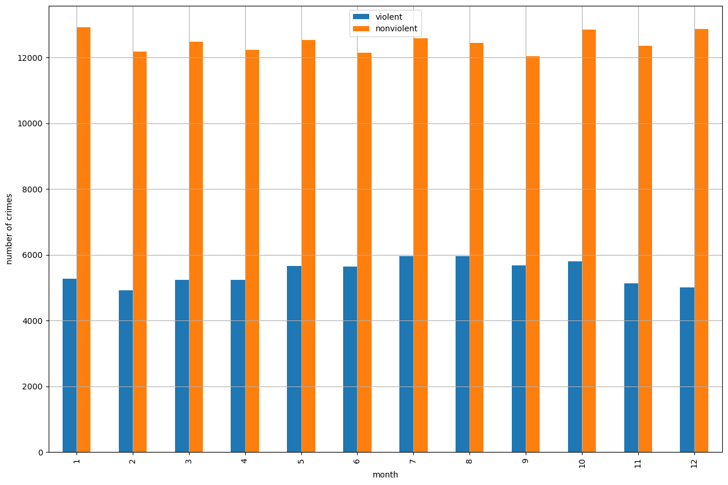
Number of Violent vs non-Violent Crimes per Month

Slide 8
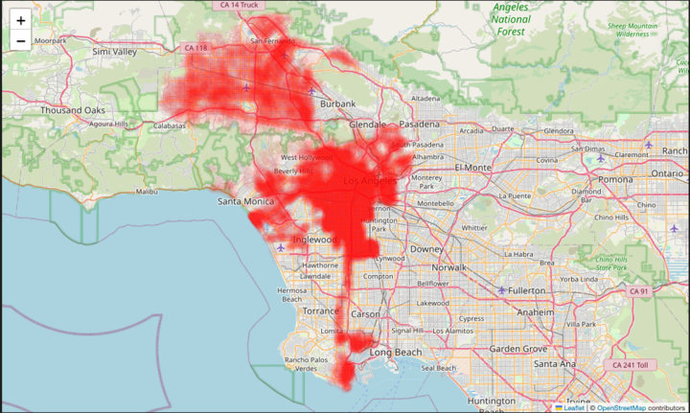
Crimes in Outside of Covid Lockdown by Area

